Slide 1
[Time Series Analysis & Forecasting Of Air Quality Index Dhaka]
Course Name: Data Mining Lab Course Code: CSE476 Intake – 41

Slide 2

Presented By –
Group No –
Name: Sheikh Rahmatulla sakib
[18192103099]
Name: Kamrun Nahar Sara
[18192103127]
Name: Md. Masudul islam Asif
[18192103147]
Name: Md. Tahmid Hossain Rasel
[18192103168]
Presented To –
Khan Md. Hasib
Assistant Professor
Department of CSE
Bangladesh University of Business and Technology (BUBT)
Email: khanmdhasib@bubt.edu.bd

Slide 3
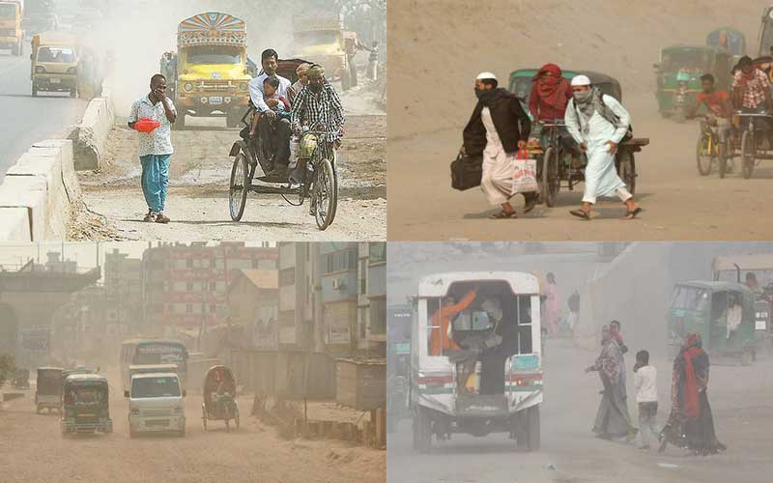
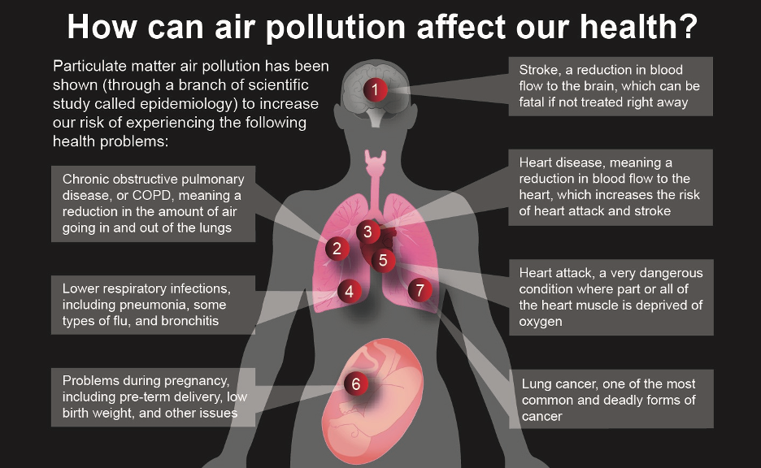
INTRODUCTION
Dhaka, one of the most densely populated cities, is the capital city of Bangladesh. It is situated by the bank of the river Buriganga.Dhaka is one of the most densely populated cities in the world, with a population of over 21 million people. The city is also known for its high levels of air pollution, which is a major public health concern.

Slide 4
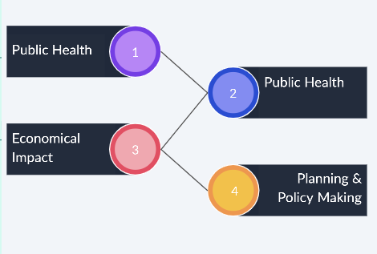
Motivation

Slide 5
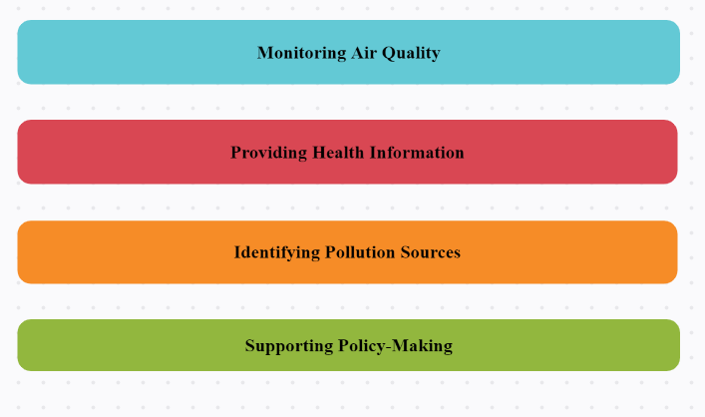
OBJECTIVES

Slide 6
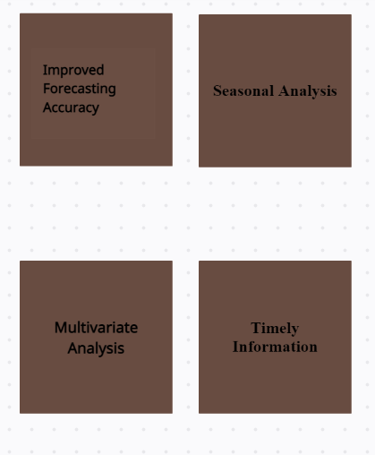
CONTRIBUTIONS

Slide 7
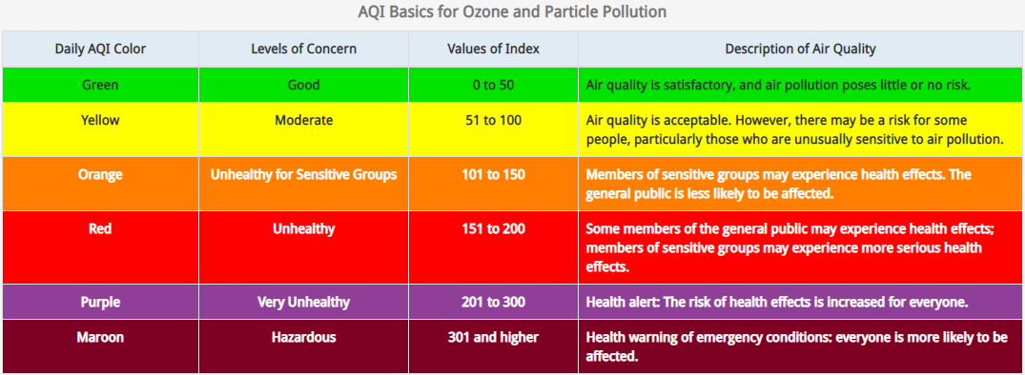
AQI Levels

Slide 8
Previous Work on Air Quality Prediction
Title: Urban air pollution: a Bangladesh perspective
Authors: M. Habibur Rahman & A. Al-Muyeed
•Analysis of the time series air quality data (of specific air pollutants, NOX, SO2, CO,O3 and particulate matters, for selected stations from the years 2002 to 2004) indicates that the ambient air of Dhaka City, the capital of Bangladesh, is polluted more than 55 percent of the year.
•The level of pollutants at 49 important road intersections shows the quality of air at the roadsides of Dhaka City.
•With the increase in the number of motor vehicles caused by economic growth and industrialization, the level of pollution is expected to worsen further in the future.
•To improve the situation, proposals for some pollution abatement measures including the introduction of unleaded gasoline and CNG-powered 3-wheelers instead of 2-stroke 3-wheelers are critically discussed in this paper.

Slide 9
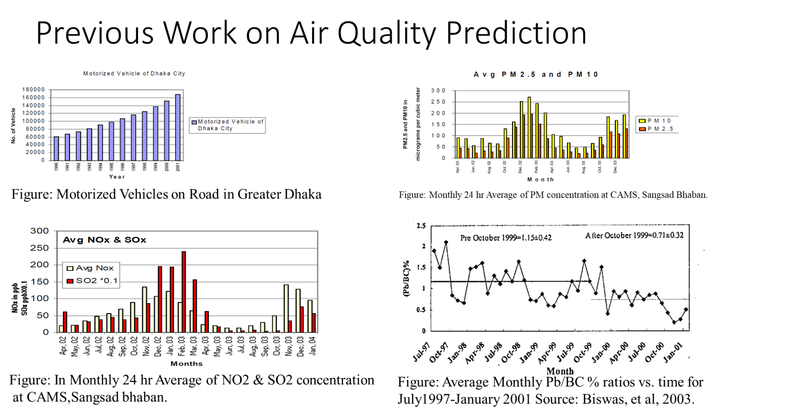

Slide 10
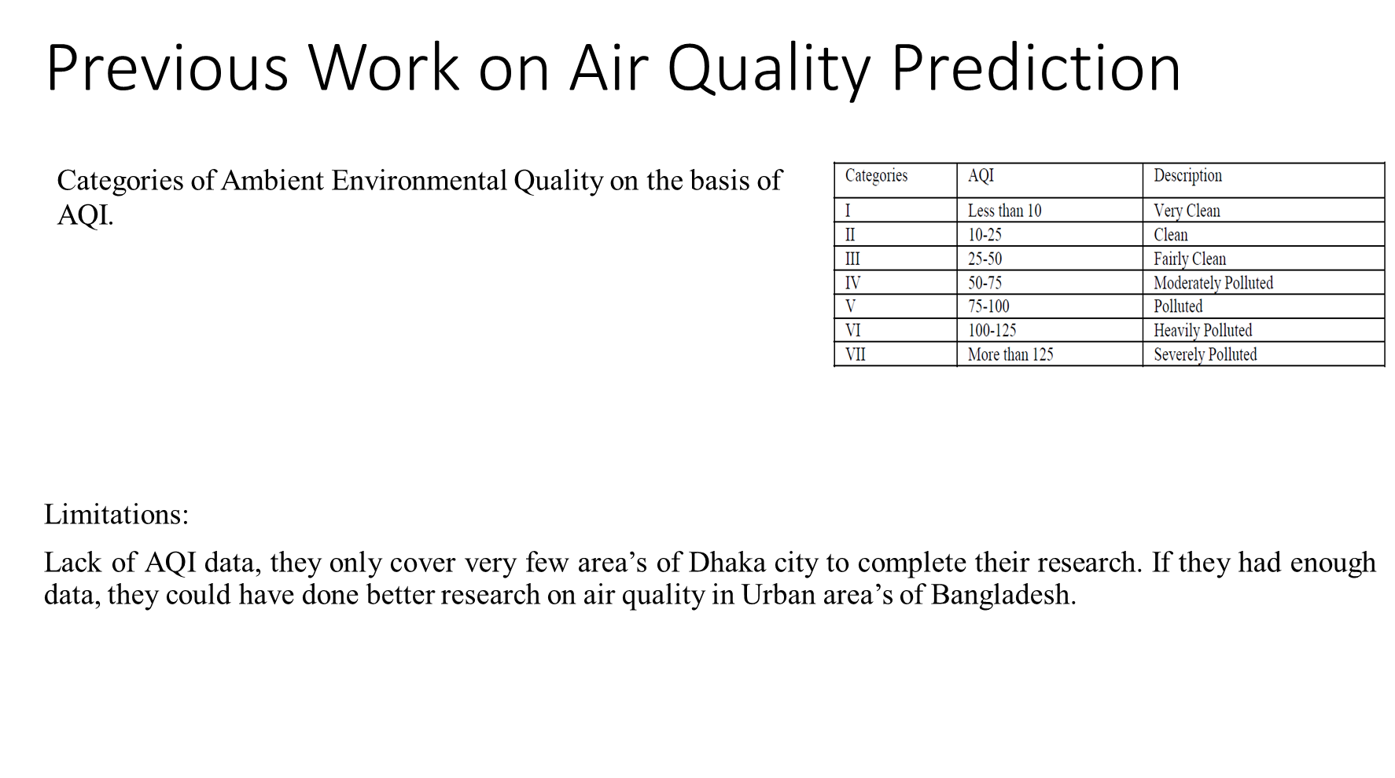

Slide 11
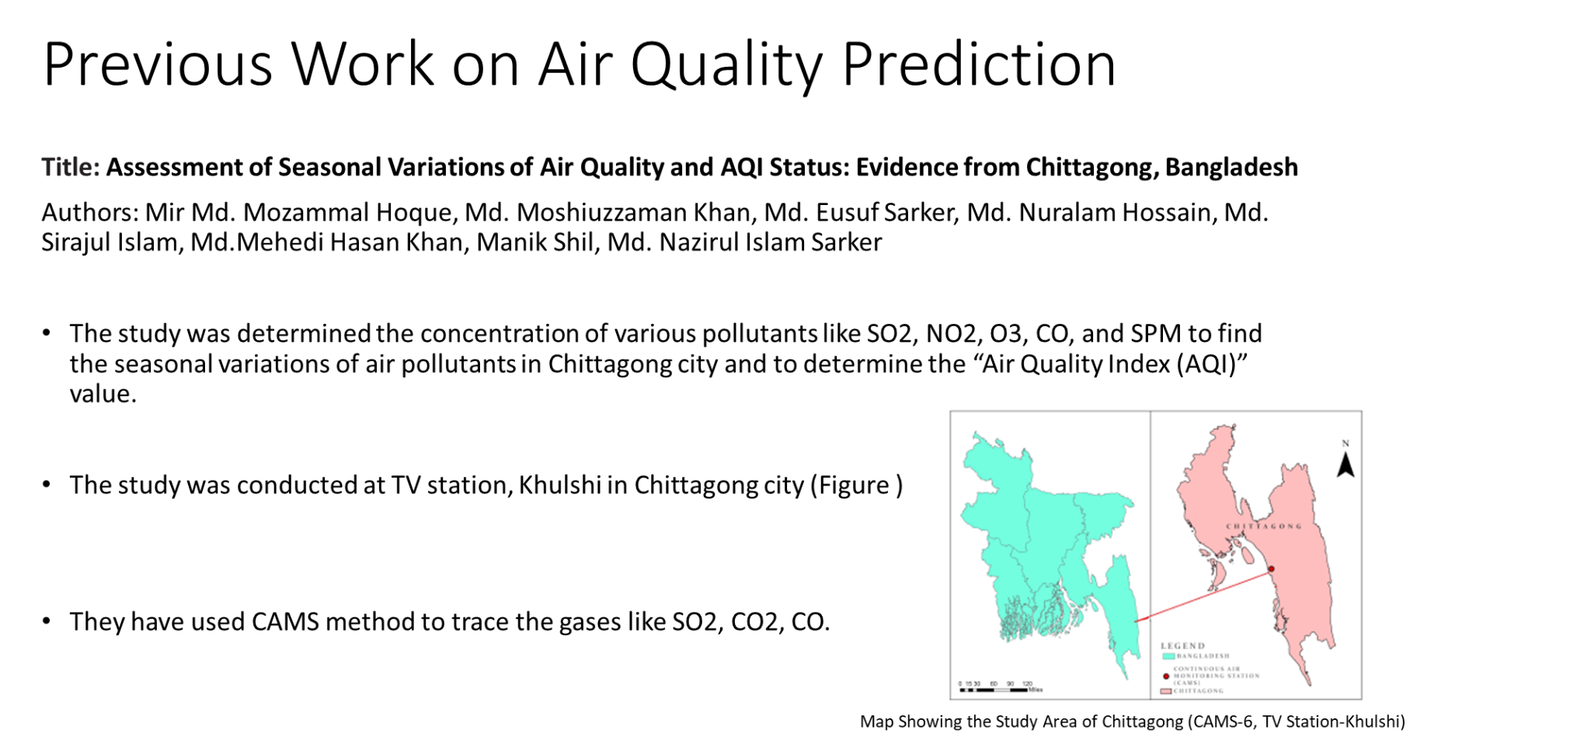

Slide 12
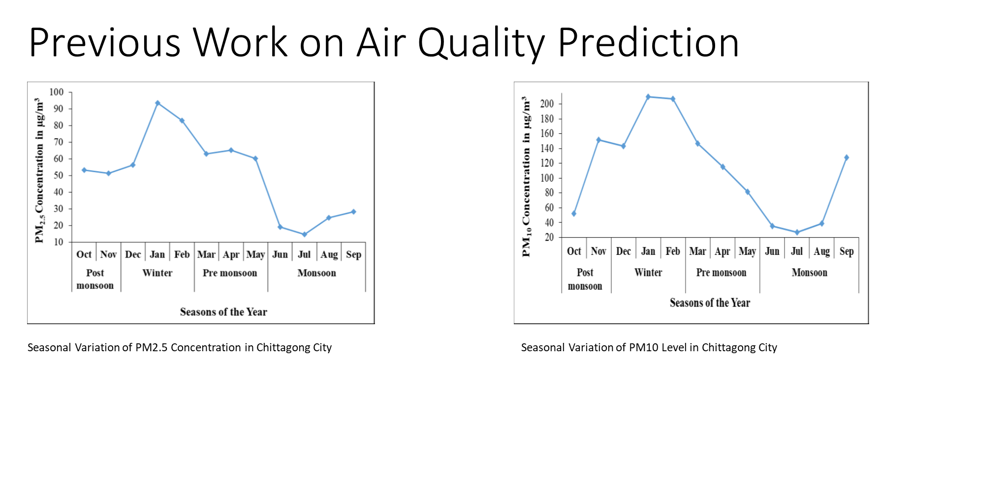

Slide 13
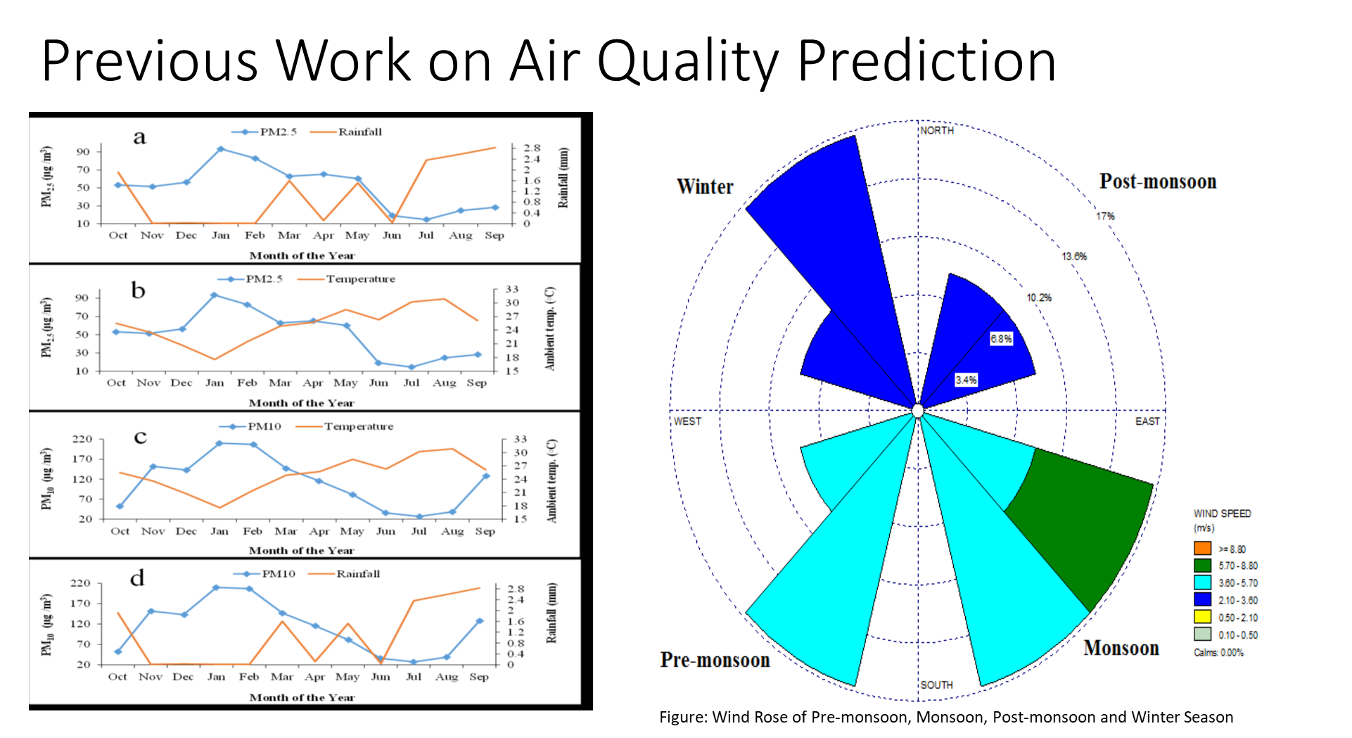

Slide 14
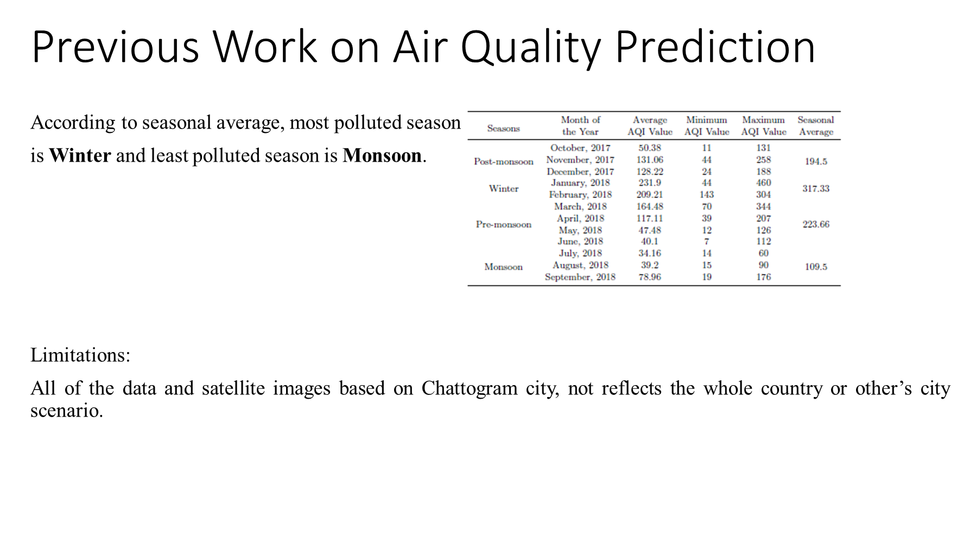

Slide 15
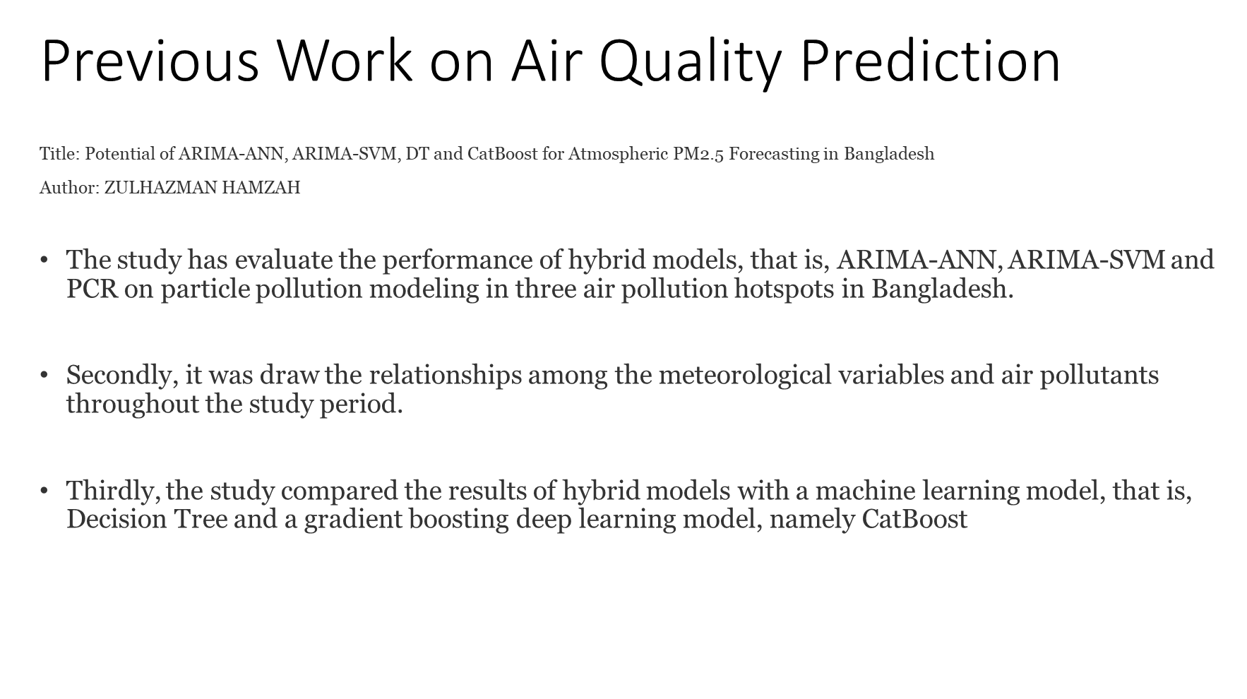

Slide 16
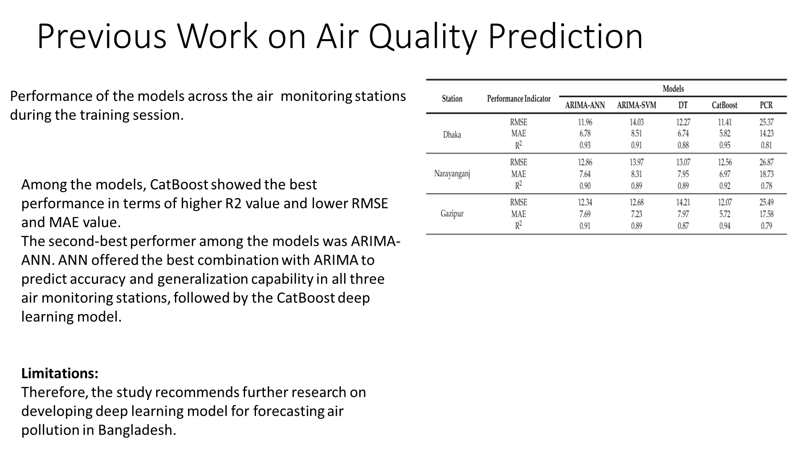

Slide 17
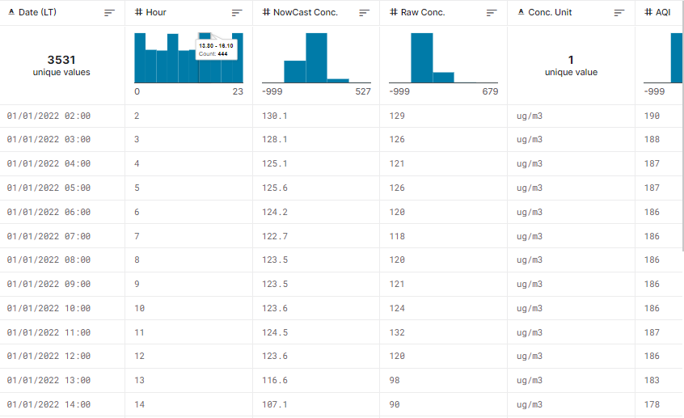
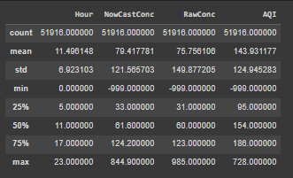
Data Collection & Understanding
Data are collected from kaggle source: https://www.kaggle.com/datasets/shawkatsujon/dhaka-bangladesh-hourly-air-quality-20162022
Here Two main column is Nowcast Concentration in micrograms/cubic meter. and Raw Concentration in micrograms/cubic meter. and Base of these column Air Quality Index is Calculated.

Slide 18
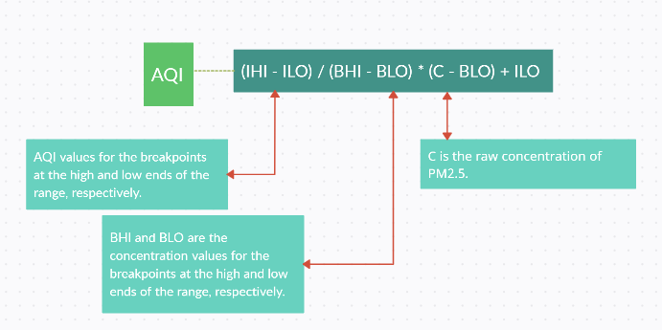
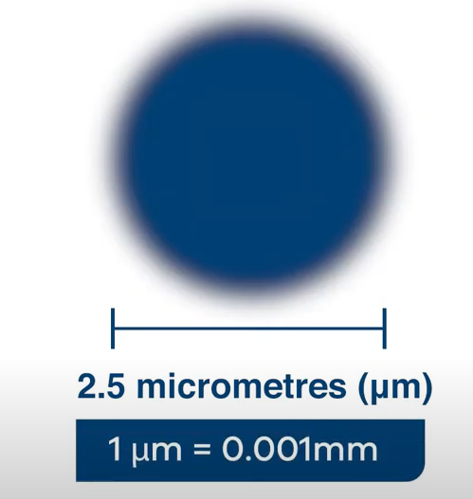
Data Calculation
Nowcast Concentration = (0.5 x C1) + (0.25 x C2) + (0.125 x C3) + (0.0625 x C4) + (0.0625 x C5)
Raw Concentration = (Mass of Pollutant) / (Volume of Air)
PM2.5 refers to fine particulate matter, which is a type of air pollutant with a diameter of less than or equal to 2.5 micrometers.

Slide 19
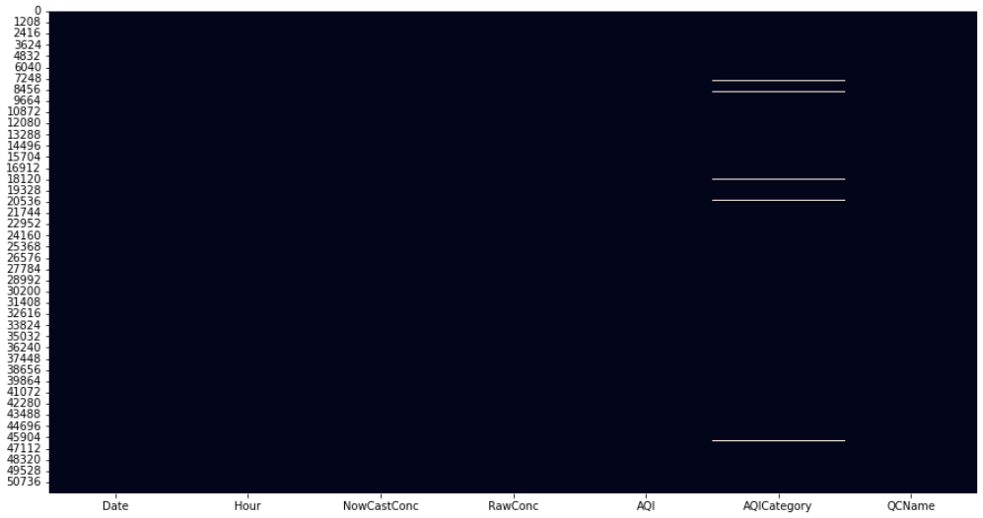
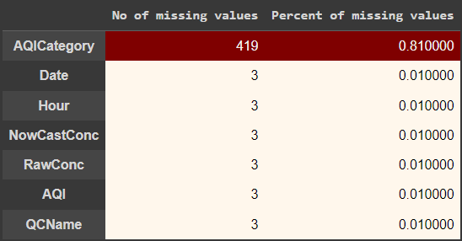
Data Cleaning & Preprocessing
values = AQI_Dhaka_city_hour.isnull().sum()
percentage = 100*AQI_Dhaka_city_hour.isnull().sum()/len(AQI_Dhaka_city_hour)

Slide 20

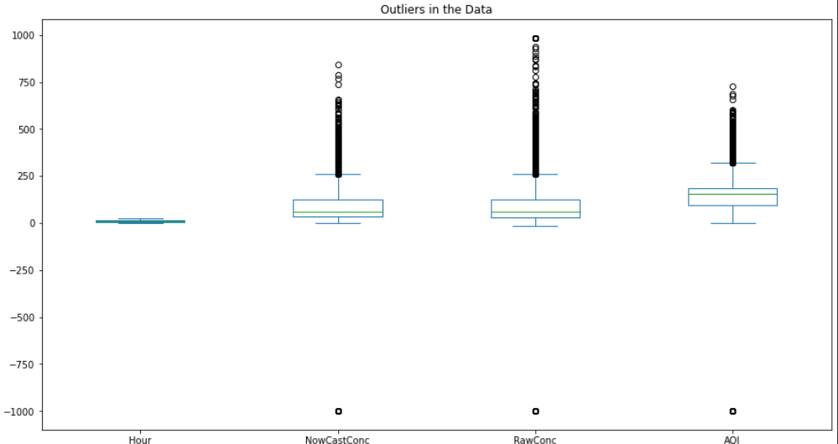
Data Fill
data_fill = data_fill.fillna(method = 'ffill',axis=0)
From the box plot, can say that the outliers are present in the data,
but this is the time series data.
So we can not remove outliers, if we do this the continuity will not
remain for the data.

Slide 21
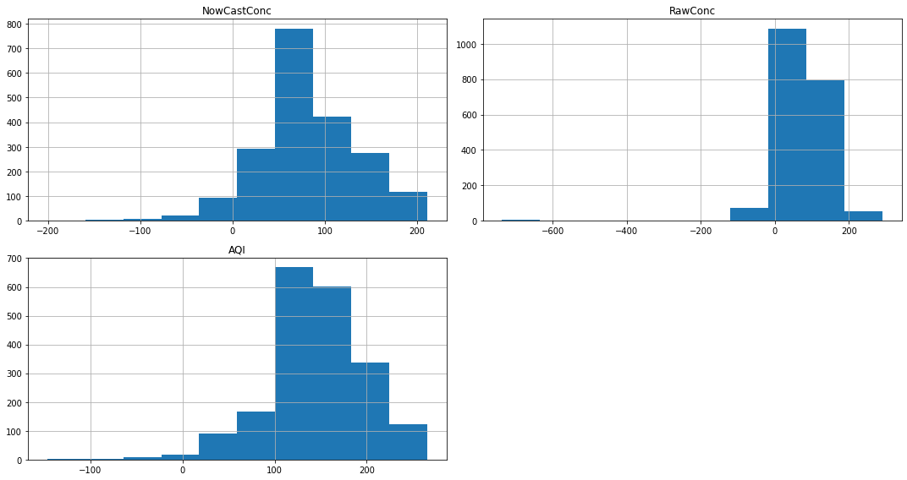
Skewness of the data
From the plot and skewness, can say that the
NewCast Conc. and ar Raw Conc are highely
skewed and Right sided.
Skewness :
NowCastConc -0.189926
RawConc -4.175744
AQI -0.619782

Slide 22
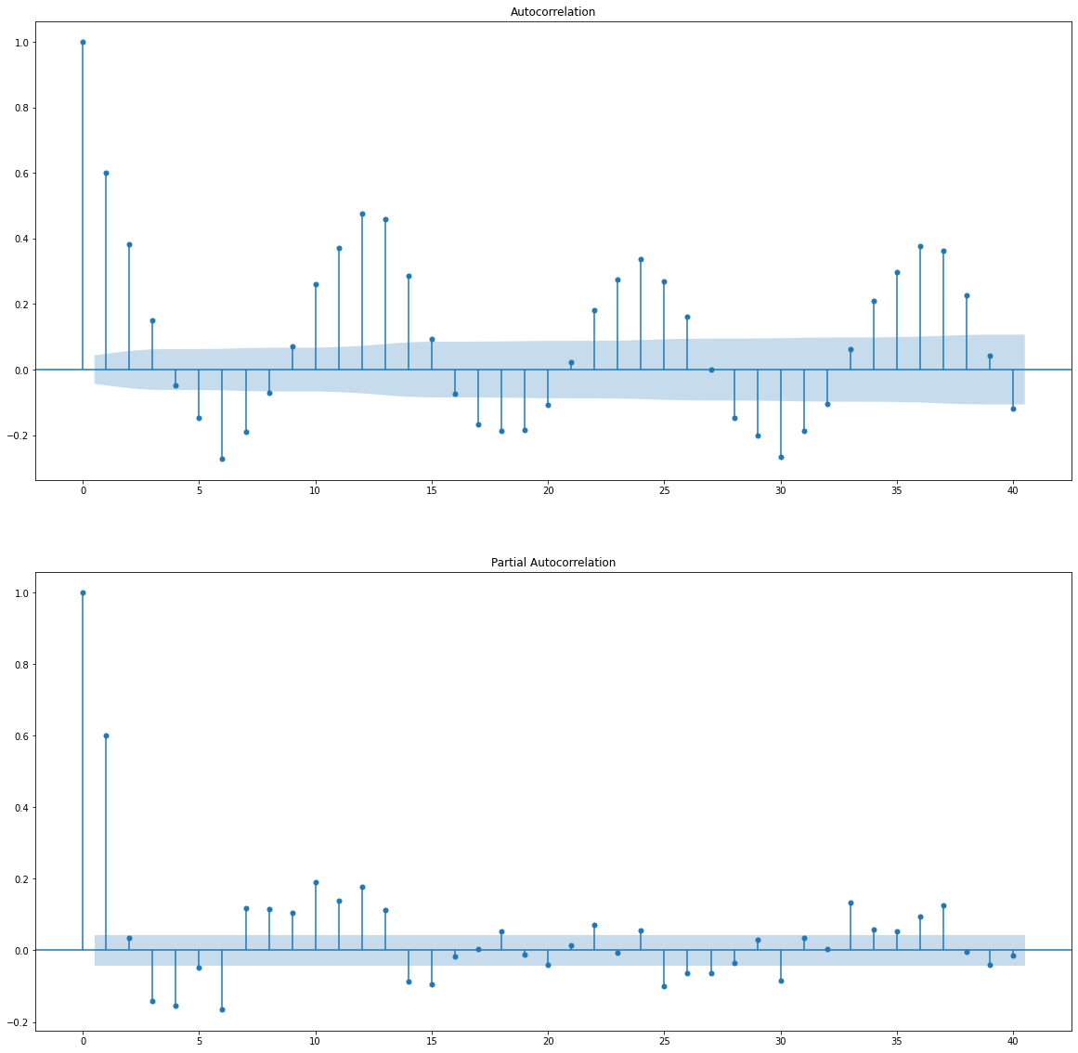
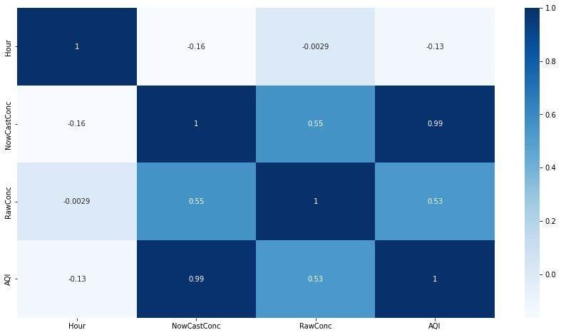
Correlation of Data & ACF , PACF

Slide 23
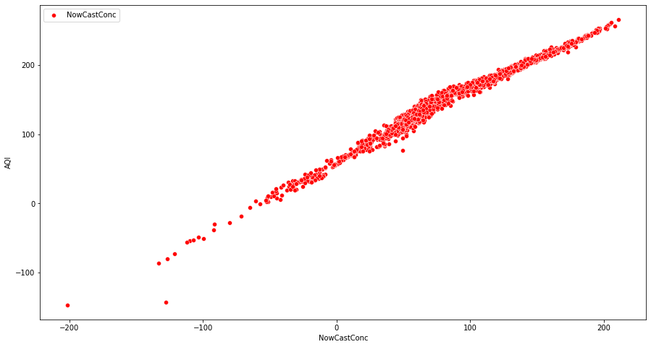
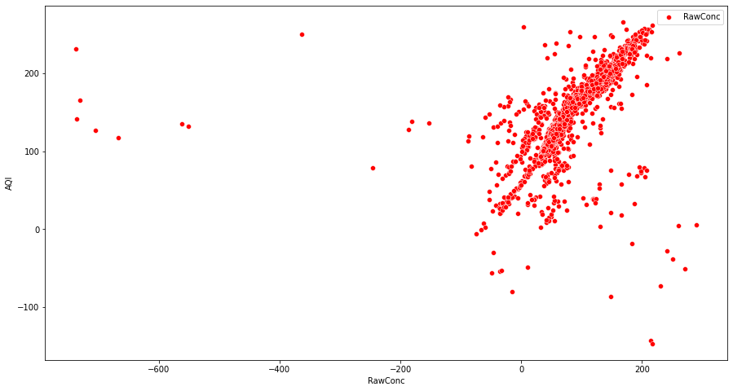
Impact on AQI

Slide 24
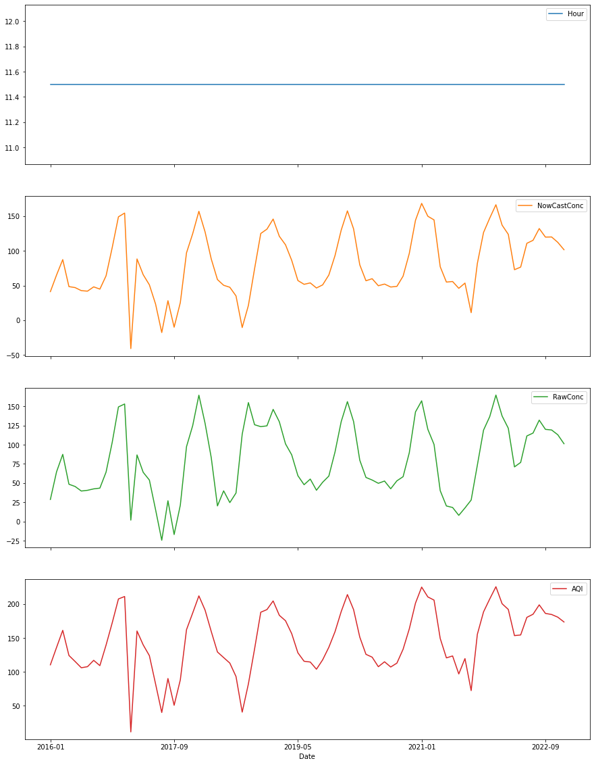
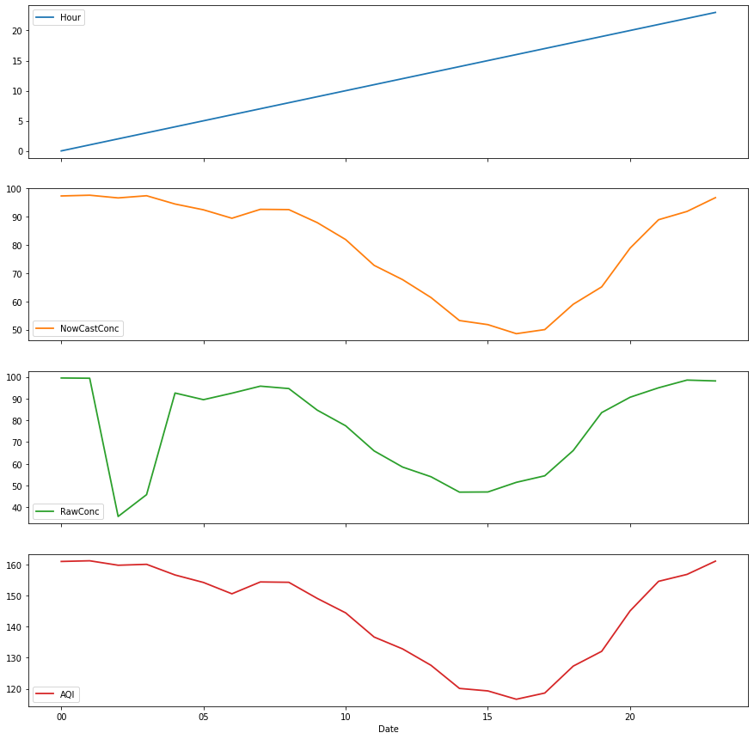
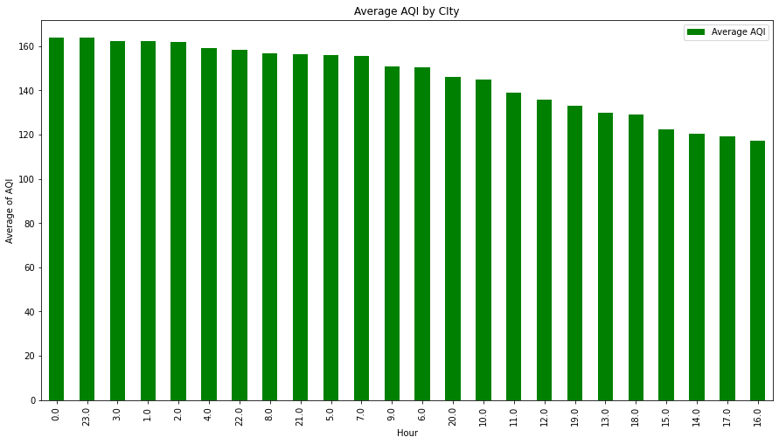
Data Visualization
Hourwise avg AQI
Yearly&Monthly visualization Hourly Visualization

Slide 25
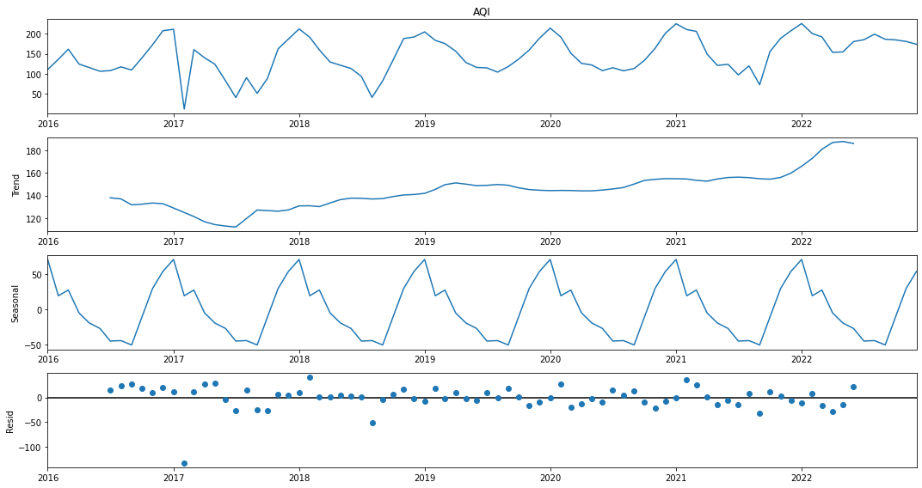
Time-series decomposition
The uppermost graph gives us Observed values
in the data.
Trend:
Seasonal:
Residual:

Slide 26
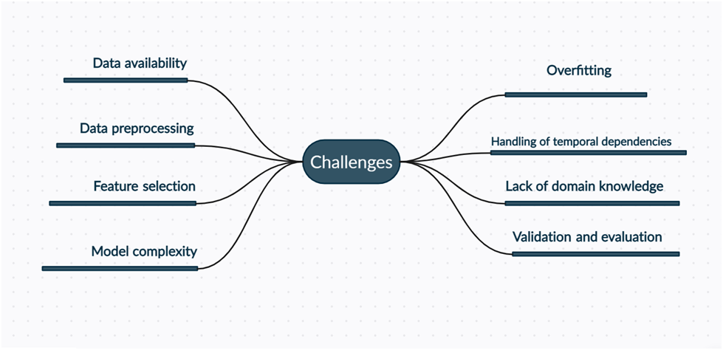
Challenges:

Slide 27
Challenges:
Data availability: obtaining high-quality and sufficient air quality data can be a challenge, especially in developing countries like Bangladesh. Data may be missing or unreliable, which can affect the accuracy of the predictions.
Data preprocessing: This can include cleaning and normalizing the data, handling missing values, and dealing with outliers.
Feature selection: Is identifying the most important features to include in the model is a key challenge.
Model complexity: Deep learning models can be complex and require a significant amount of computational resources.
Overfitting: Overfitting can occur when a model is too complex and starts to memorize the training data, instead of generalizing to new data

Slide 28
Challenges:
Handling of temporal dependencies: Air quality data is time-series data, and the model needs to handle temporal dependencies effectively to make accurate predictions.
Lack of domain knowledge: Air quality prediction is a complex problem and requires domain knowledge in fields such as atmospheric science, meteorology, and environmental engineering.
Validation and evaluation: Evaluating the performance of the model can be challenging, as there may not be a large amount of data available for testing,

Slide 29
Future scope:
For future research, we recommend exploring the use of machine learning techniques to improve the accuracy of AQI forecasting in Dhaka. Machine learning algorithms can be used to predict the health impacts of air pollution on the residents of Dhaka, which can inform policy decisions and public health interventions. Additionally, incorporating more data sources and variables, such as weather data and traffic patterns, may improve the accuracy of AQI forecasting.
Incorporating additional data sources: The model could be further improved by additional data sources such as weather forecasts, traffic data, and land-use data.
Ensemble models: Ensemble models , which combine multiple models to make predictions, could be used to improve the accuracy of the prediction. this could be combining an LSTM model with other types of models such as Random Forest or Support Vector Machines.

Slide 30
Future Scope
Model interpretability: The model would allow to identify which features are most important in making predictions.
Online learning: The model could be adapted to an online learning scenario, where it can be updated with new data in real-time and make predictions on the fly.
Deployment: The model could be deployed in a web or mobile app, which would allow individuals and organizations to access air quality predictions and make informed decisions about actions to take to improve air quality and protect public health.
Model fine-tuning: The model could be fine-tuned to increase the accuracy of predictions. By experimenting with different architectures, optimizers and regularization techniques
Comparison with other models: The predictions of the LSTM model could be compared with other models like Random Forest, Support Vector Machines and other deep learning models to evaluate the performance

Slide 31
Thank You All

